Slide 1


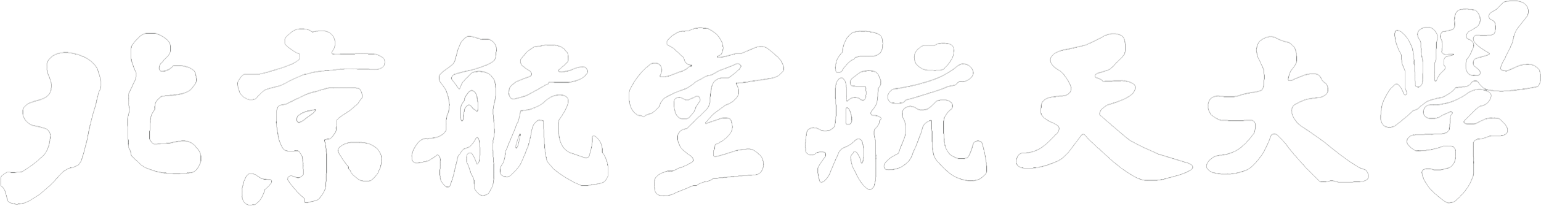
A Transformer-based Knowledge Graph Embedding Model Combining Graph Paths and Local Neighborhood
Beihang University
Tong Zhu, Huobin Tan, Xinyu Chen, and Yating Ren
School of Software
Beihang University, Beijing, China
Notes:
Good [morning/afternoon/evening] everyone, today I will be presenting our recent research findings in the field of Knowledge Graph Embedding. MY name is zhutong and the title of the paper is A Transformer-based Knowledge Graph Embedding Model Combining Graph Paths and Local Neighborhood . And This paper has been accepted by 2024 IEEE World Congress on Computational Intelligence
.
This work was conducted by our team at the School of Software, Beihang University.

Slide 2
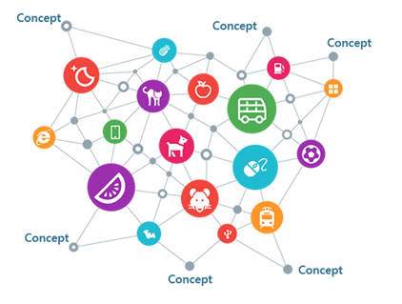



Introduction
Knowledge Graph
Completion
Knowledge Graph Embedding (KGE)
Projects entities and relations
into a low-dimensional vector space
Question Answering
Recommendation System
Sematic Search
Notes:
Before we dive into our research, let‘s briefly discuss the fundamental concept of Knowledge Graphs. Knowledge Graphs are structured knowledge bases that are extensively used in semantic search, question-answering systems, and recommendation systems, among other applications. Despite their utility, even large-scale Knowledge Graphs suffer from incompleteness, which restricts their real-world applications. As a result, Knowledge Graph Completion (KGC) has emerged as an active research area.
Currently, the mainstream solution for KGC is knowledge graph embedding (KGE) . It projects entities and relations into a low-dimensional vector space and employs scoring functions to assess the plausibility of fact triples.

Slide 3
Existing KGE models
Early Models
Translation based, such as TransE, TransR, TransH
Tensor factorization based, such as DistMult, ComplEx
Convolutional neural networks (CNN) based, such as ConvE
Unable to utilize the graph structural information
GNN-based Models
Employ graph convolutional neural networks to leverage the local neighborhood structures of entity.
Restricted in expressiveness because of the shallow network architecture
The issue of over-smoothing further limits the model‘s ability in capturing long-distance information.
Notes:
Among existing Knowledge Graph Embedding methods，the early approaches primarily utilized the geometric properties of vector space , but these methods unable to utilize the graph structrual information in kg.GNN-BASED models employ graph convolutional neural networks to leverage the local neighborhood structures of entity, achieved incremental success but still have limitations. On one hand, the expressiveness of models is constrained due to the shallow neural network architectures. On the other hand, as the number of GNN layers increases, existing methods encounter a performance degradation issue known as over-smoothing [10], consequently restricting the ability to capture information beyond the local neighborhood of entities

Slide 4
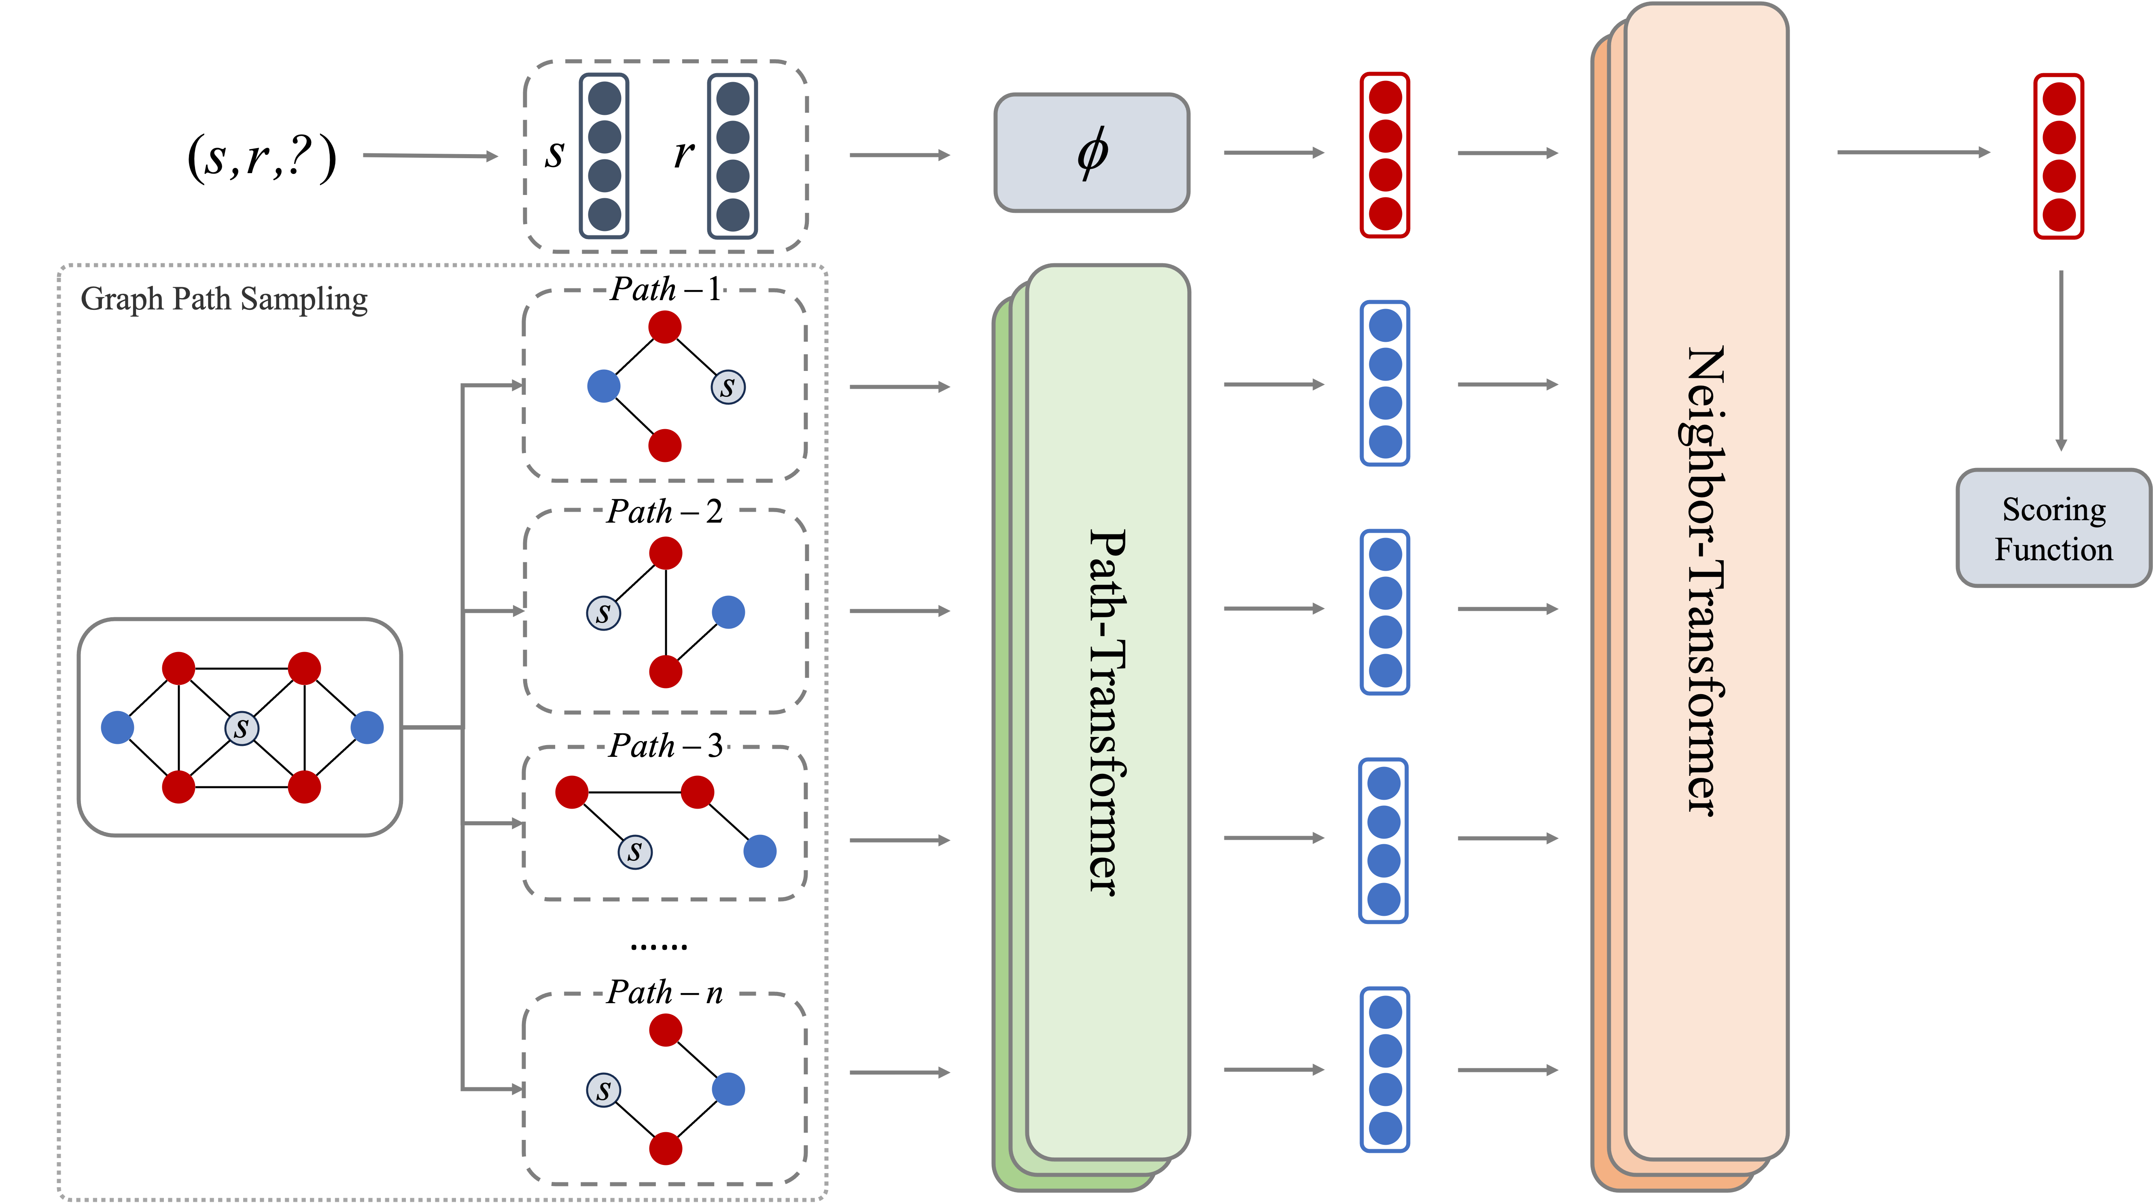
Our Solution: TKGE-PN
Transformer-based knowledge graph embedding method that combines graph paths and local neighborhood
Combine graph paths with local neighborhood
Better learn long-distance dependencies
avoiding the problem of over-smoothing
Transformer-based
Self-attention mechanism provides TKGE-PN a more powerful expressive capacity.
Notes:
To address these issues ,In this paper, we present TKGE-PN, a Transformer-based knowledge graph embedding model that combines graph paths and local neighborhood. Compared to local neighborhood, graph paths can help the model better capture long-distance dependencies between entities, By combining graph paths with local neighborhood, the model can better utilize the graph structure in KGs to learn long-distance dependencies while avoiding the problem of over-smoothing. Moreover, In contrast to the shallow neural network architecture of GNN, the selfattention mechanism in Transformer provides TKGE-PN with a more powerful expressive capacity.

Slide 5
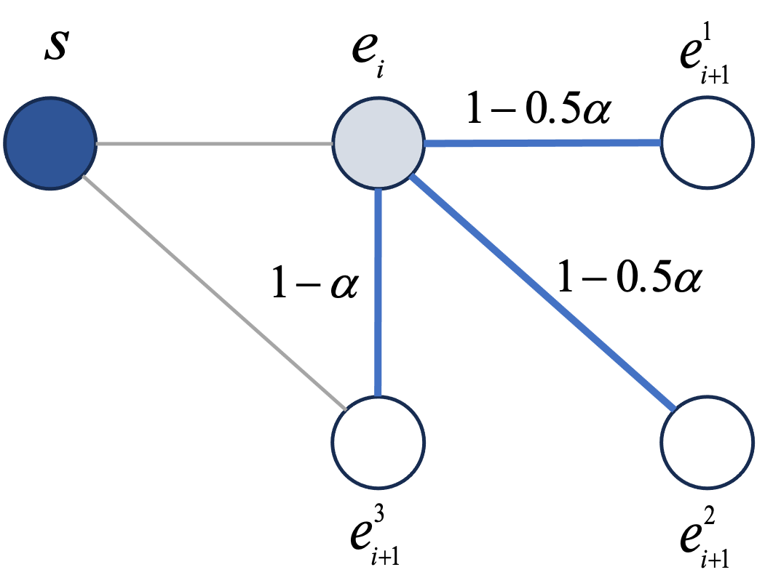
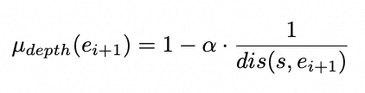
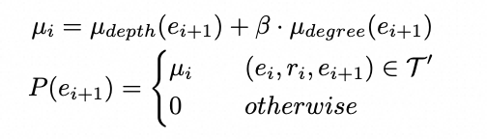
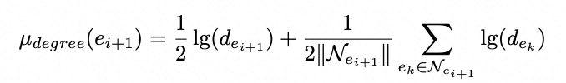
Biased Random Walk Graph Path Sampling
Problem-1
Impossible to traverse all graph paths within the graph
Samples a number of graph paths equal to the node degree of the central entity , rather than a fixed value.
Problem-2
Not all paths contribute meaningfully to high-quality knowledge graph embeddings.
Biased random walks
Depth bias
Degree bias
Notes:
Our approach begins with a biased random walk algorithm that samples multiple graph paths starting from the central entity. Due to the often large scale of knowledge graphs, it is impossible to traverse all graph paths within the graph. Previous path-based methods, such as RSN, tend to utilize only 1-2 graph paths when scoring factual triples, which is extremely limited compared to the potential number of paths in a knowledge graph. to address the issue of insufficient graph path sampling . the proposed algorithm samples a number of graph paths equal to the node degree of the central entity s, rather than a fixed value. Moreover, not all paths contribute meaningfully to high-quality knowledge graph embeddings. to ensure that the sampled paths are of high quality and beneficial for knowledge graph embedding, the sampling algorithm uses biased random walks to determine the entities and relations selected at each step in the graph paths. In order to better capture long-distance dependencies, the algorithm aims to sample paths that are further away from the starting point, and a depth bias µdepth is used to control this. dis(s, ei+1) is the length of the shortest path between s and ei+1.
In addition to path depth, the graph path sampling module also takes into account the degrees of the entities. the degree is also an an important structural information in the knowledge graph. reflects the global importance of entities in the knowledge graph. A higher degree indicates higher importance and richer implied information. Therefore, in the sampling process, entities with higher degrees should have higher weights. We use degree bias to control it. Finally, we can get the probability formula for selecting the next hop relation and entity

Slide 6
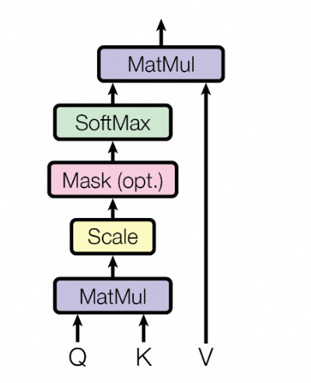
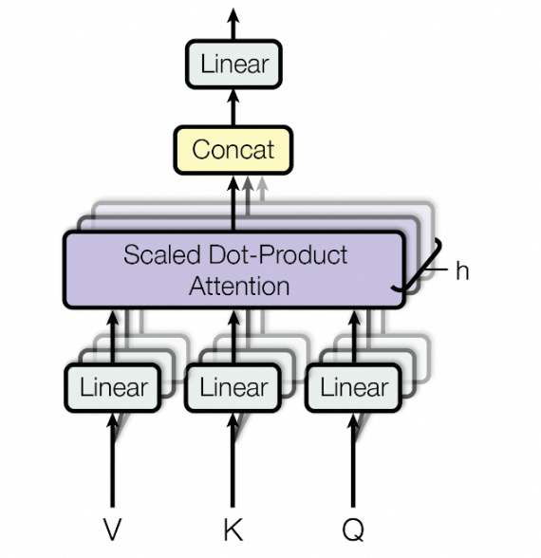
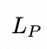
Path-Transformer
Path-Transformer
Use Transformer to
extract the semantic information.
Masked Entity and Relation Prediction
E_{PATH}
E_{MERP}
e₁
E_{CLS}
e_{s}
r₁
[mask]
r₂
e₂
Enhance the Path-Transformer’s ability
to extract information from path contexts.
Notes:
The sampled graph paths from the path sampling module cannot be used directly; they need to be processed to extract the semantic information and convert it into vector representations by our Path-Transformer module. Utilizing the self-attention mechanism, it captures the nuanced interplay between entities and relations along each path. The inputs to the Path-Transformer module primarily consist of the two components: the graph path embedding Mpath, as well as the embedding of special [CLS] token. Similar to BERT [33], we use type embeddings to differentiate the embeddings of entity,relation and [CLS]. use positional embeddings to represent the sequential relationships between entities and relations in the graph path. we select the output embedding corresponding to the [CLS] to serve as the vector representation of the current graph path.besides, , compared to short-distance local neighborhoods, learning the long-distance information contained in graph paths is undoubtedly more challenging. To address this challenge, inspired by the Masked Language Model (MLM) pretraining task in BERT, we propose the Masked Entity and Relation Prediction (MERP) task to enhance the PathTransformer’s ability to extract information from path contexts. Specifically, for the input graph path P, the model randomly select a proportion of relations or entities for the prediction task. Taking entity as an example, the selected entity em will be replaced with a special mask token [MASK], another random entity, or remain unchanged, the model uses the embedding Em corresponding to the masked entity from the output MP output to predict and retrieve the correct source entity em

Slide 7
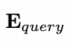
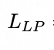
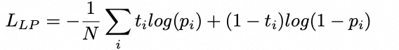
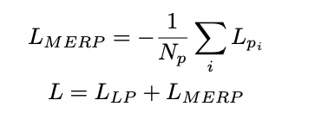
Neighbor-Transformer
Combine both local neighborhood information and graph path information
Graph paths cover the first-order neighborhood of the central entity
Model completes the learning of local neighborhood information while aggregating path information
Notes:
The Neighbor-Transformer module is responsible for integrating all the graph path information encoded by the Path-Transformer module and calculating the score of the triple to be predicted. Since these graph paths can cover the first-order neighborhood of the central entity s, the model can combine both local neighborhood information and graph path information from the knowledge graph. The input to the Neighbor-Transformer neighborhood information encoding module mainly consists of there parts: the embedding matrix of graph paths Mpaths, the query embedding Equery, and the embedding of special [GCLS] token EGCLS. the embedding matrix of graph paths is composed of the embedding representations of all sampled graph paths starting from the central entity. Equery is is calculated from the embeddings es and er corresponding to the entity s and relation r. Through Equery, the NeighborTransformer module is able to capture the information of the triple to be predicted. . Finally, we take the embedding corresponding to the EGCLS in the output for the link prediction,and get the final loss used for model training can be obtained by adding the loss of the link prediction task and the masked entity relation prediction task.

Slide 8
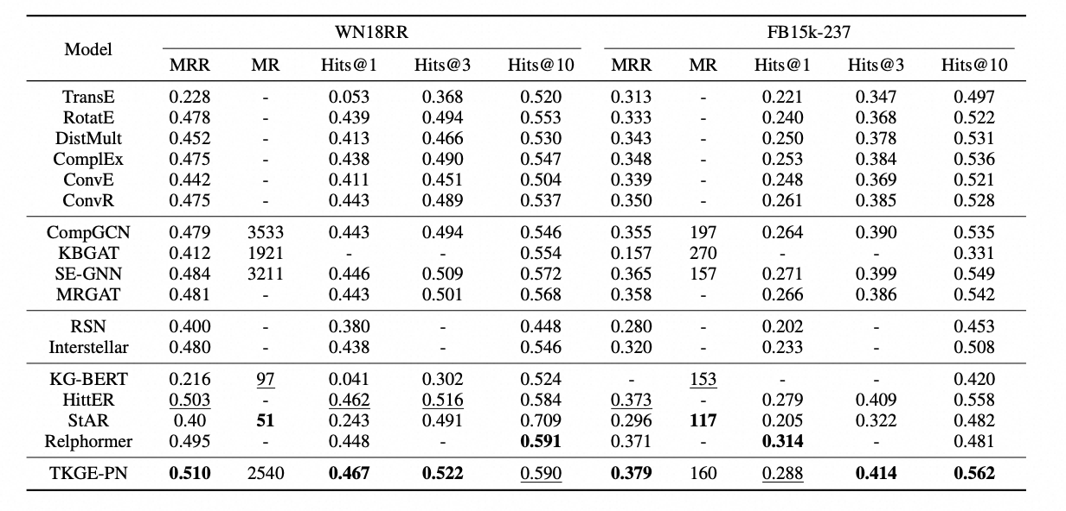
Experimental Results
Link Prediction Results:
Notes:
“We evaluated TKGE-PN on two benchmark datasets: FB15k-237 and WN18RR. From the link prediction result, we can observe that:the TKGE-PN model outperforms all other baseline models, demonstrating the effectiveness of the method proposed in this paper, compared to graph convolutional neural network-based embedding methods, Transformer-based embedding methods have achieved significant performance improvements, proving the potential of the Transformer structure in the field of knowledge graph. Among Transformerbased knowledge graph embedding methods, HittER utilizes the Transformer to learn first-order neighborhood information of central entities without utilizing path information, thus lacking the ability to capture long-distance dependencies in the graph. The performance improvement of TKGE-PN relative to HittER highlights the utility of graph path structures for knowledge graph embeddings and TKGE-PN’s capability to mine long-distance dependencies from graph path structures embeddings.

Slide 9
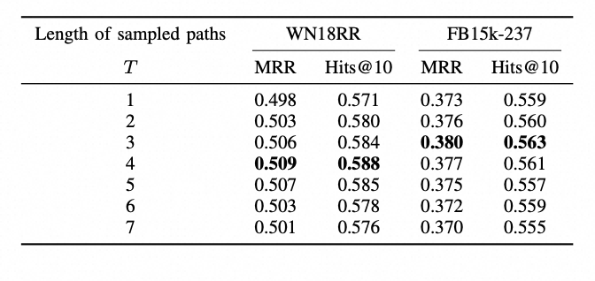
Link Predictions Results Under different Sample Length
Performance generally shows a trend of first increasing and then decreasing.
Performance discrepancy of the model on the two datasets is due to the varying sparsity levels of the datasets
Notes:
To further investigate the impact of the graph path sampling strategy on the link prediction performance of TKGE-PN, we explored its performance on the two datasets at different graph path sampling lengths. It can be observed that as the length of sampled paths T increases, the performance of the model on both datasets generally shows a trend of first increasing and then decreasing. an increase in path length can help the model learn long-distance dependencies, thereby effectively improving the embedding effect in the initial phase.but When the sampling length is too high, the randomness of the sampled paths also increases, leading to the introduction of more noise information, which in turn causes interference with the model and results in a decrease in performance. Moreover, we can find that the optimal sampling length differs across datasets. We believe that such differences are due to the disparity in sparsity between the datasets; the WN18RR dataset is relatively more sparse, which reduces the randomness of sampling and introduce less noise data.

Slide 10
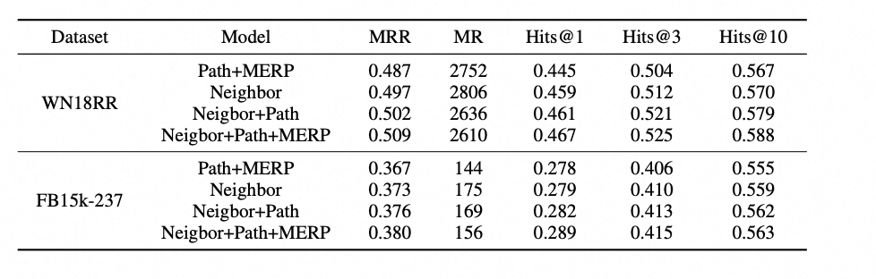
Ablation Study
Removal of either the local neighborhood encoding module or the graph path encoding module results in a noticeable decrease in the performance
Addition of graph path information without the masked entity-relation prediction task does not lead to a significant improvement in performance.
Notes:
To verify the effects of different part of model, we conduct ablation experiments with different settings. It can be observed that the removal of either the local neighborhood encoding module or the graph path encoding module results in a noticeable decrease in the model’s performance. The experiments demonstrate that both types of structural information in knowledge graphs facilitate link prediction. Furthermore, we can oberserve that the addition of graph path information without the masked entity-relation prediction task does not lead to a significant improvement in performance, illustrating the challenge of learning long-distance dependencies on the graph path and the role of the masked entity-relation prediction task in enhancing the model’s ability to learn long-distance dependencies.

Slide 11
Conclusion
Contribution
In this paper, we proposed TKGE-PN,which achieves a comprehensive learning of both short and long-distance dependencies by fusing two types of structural information from knowledge graphs.
Conduct experiment on two dataset and demonstrate the effectiveness of our approach.
Thank you for attention!
Notes:
In this paper, we proposed TKGE-PN, a Transformerbased knowledge graph embedding method that combines graph paths and local neighborhoods, By fusing two types of structural information from knowledge graphs and leveraging the powerful expressive ability of the Transformer model, TKGE-PN achieves a comprehensive learning of both short and long-distance dependencies within the graph. On two standard datasets, TKGE-PN outperforms the majority of existing embedding models in link prediction tasks, demonstrating the effectiveness of the proposed method.

